Slide 1
New Way RA
Jez Layman—Indian Prairie Public Library
Stacey Peterson – Batavia Public Library
Emily Borsa – Hinsdale Public Library

Slide 2
3 Quick Boosts
Jez Layman

Slide 3
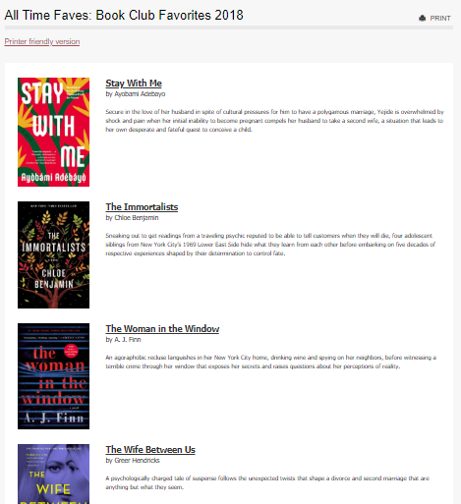
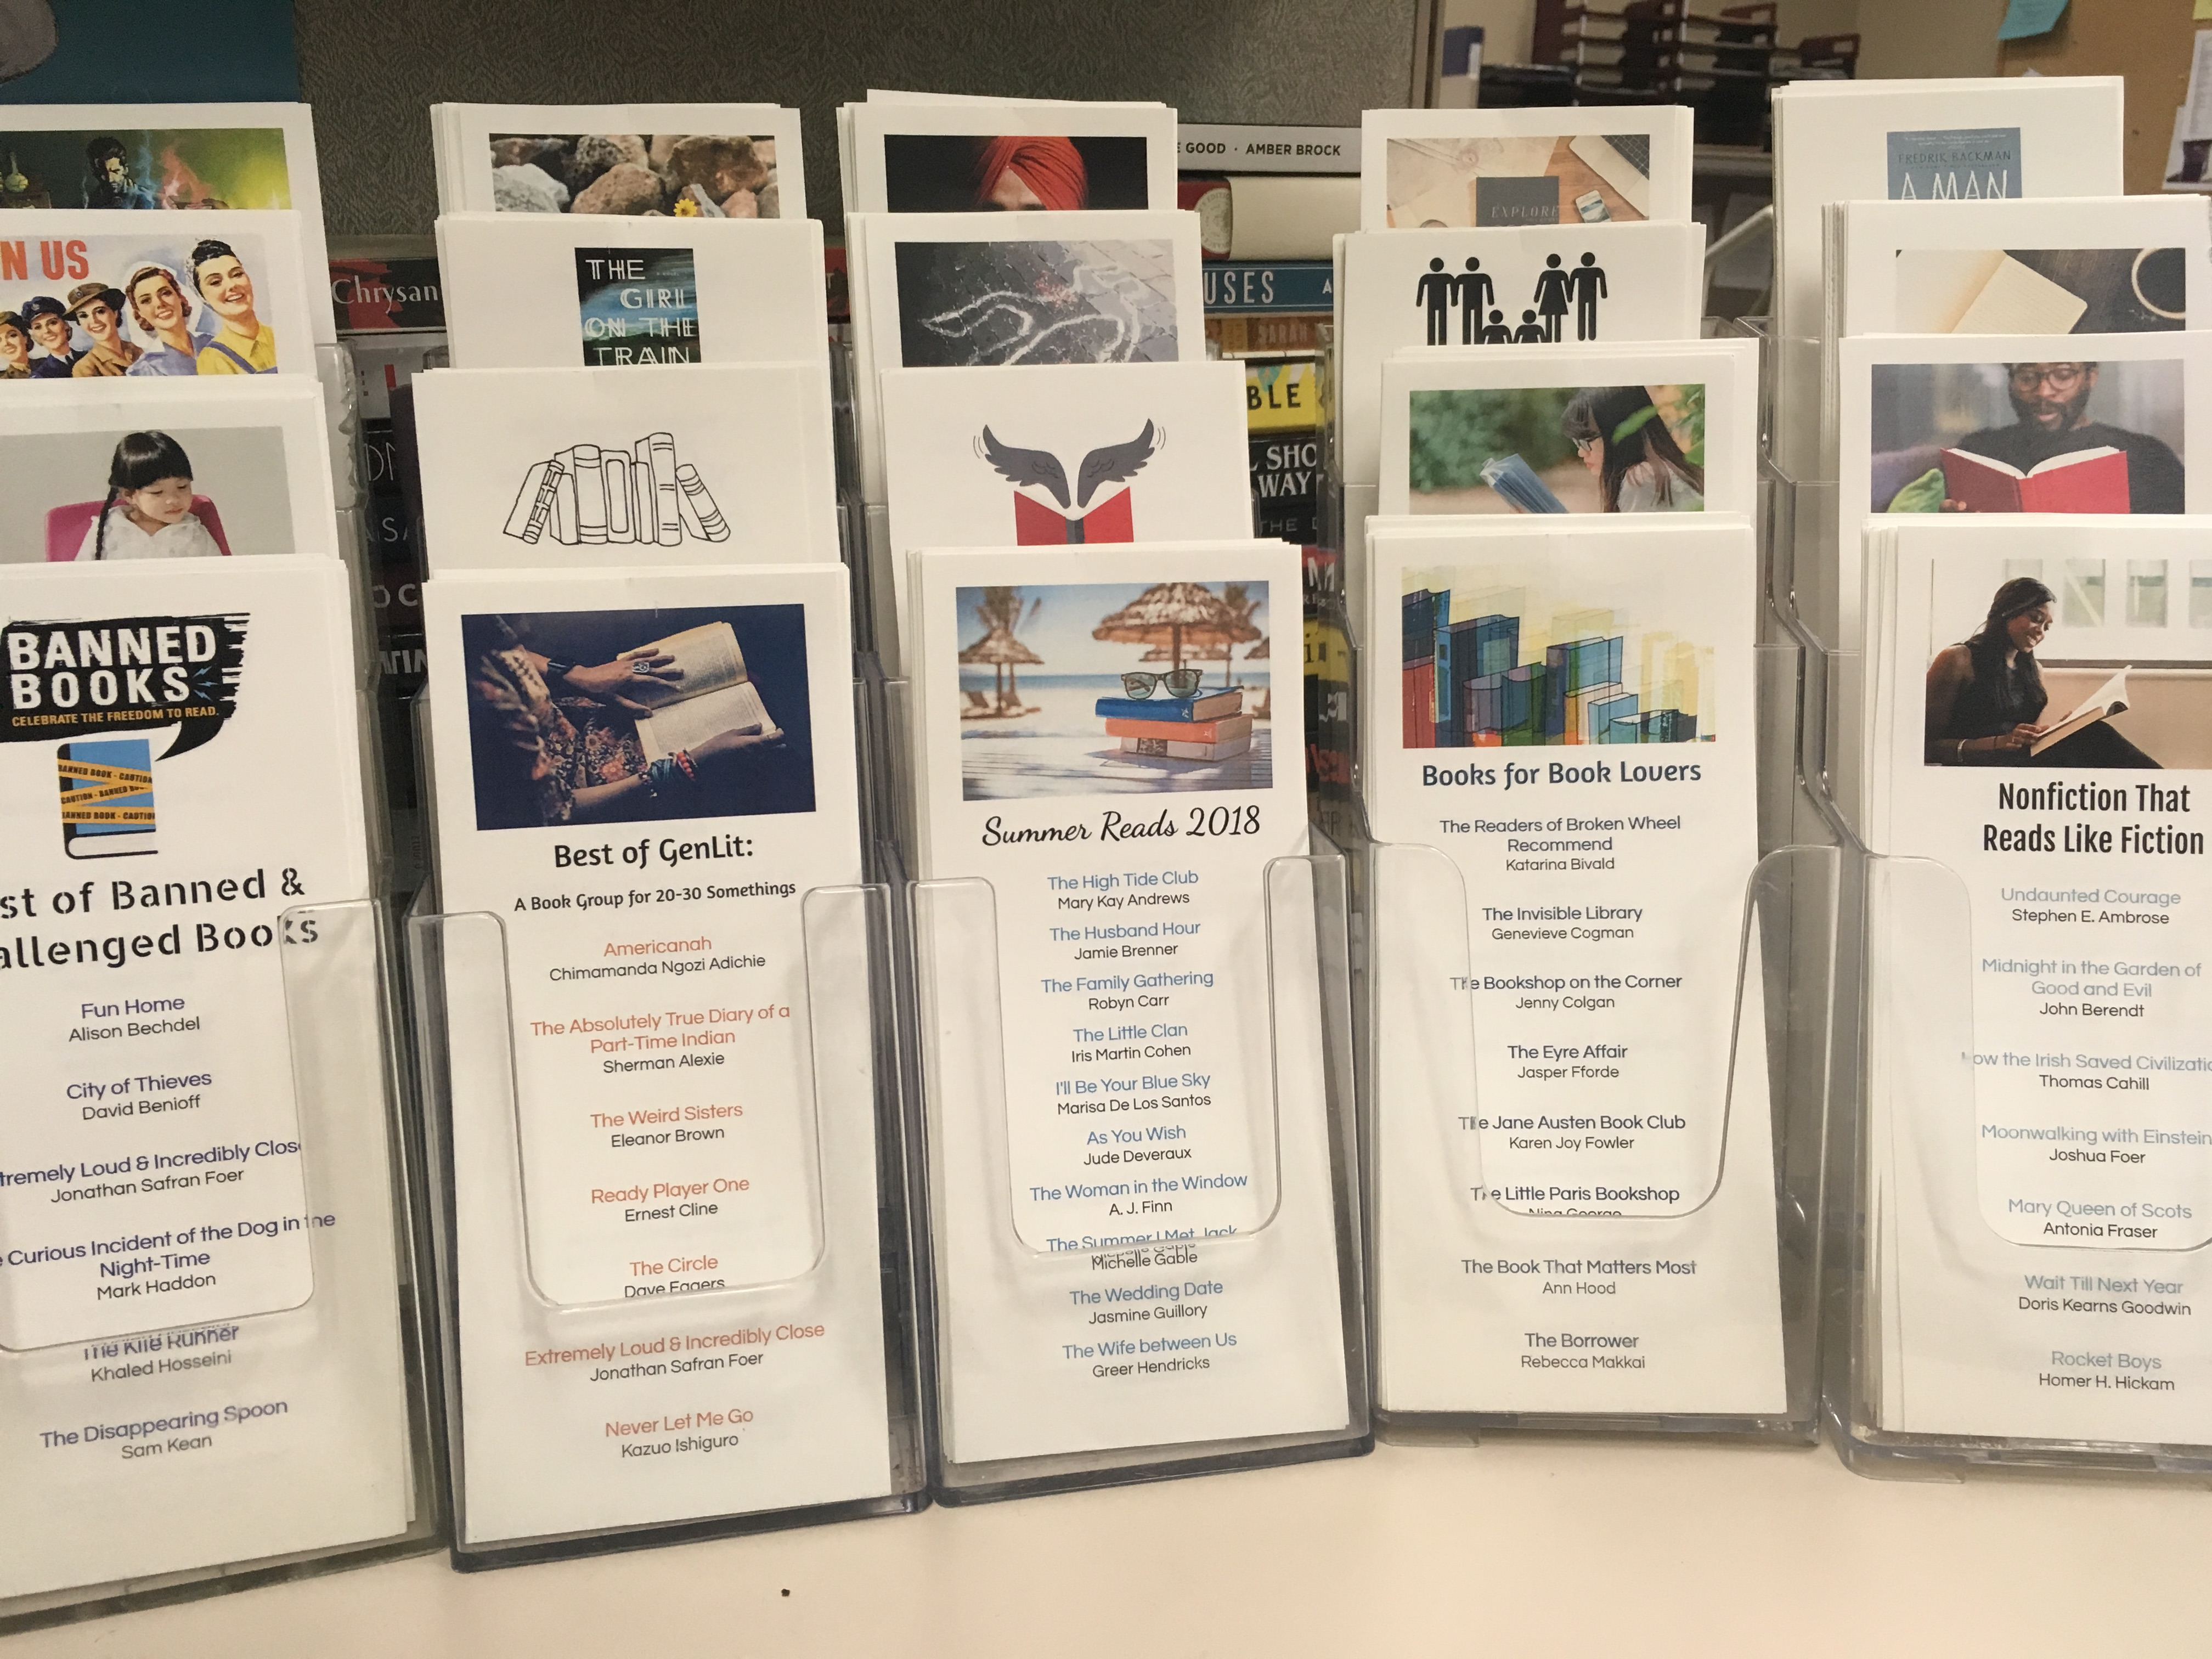
Maximize the reach of your recommendations
Don’t reinvent the wheel. Take advantage of work you’ve already done.
Once you have a bibliography, you can turn it into… bookmarks!

Slide 4
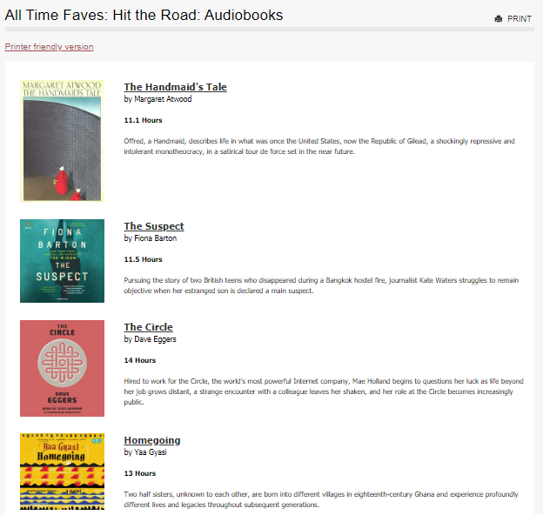
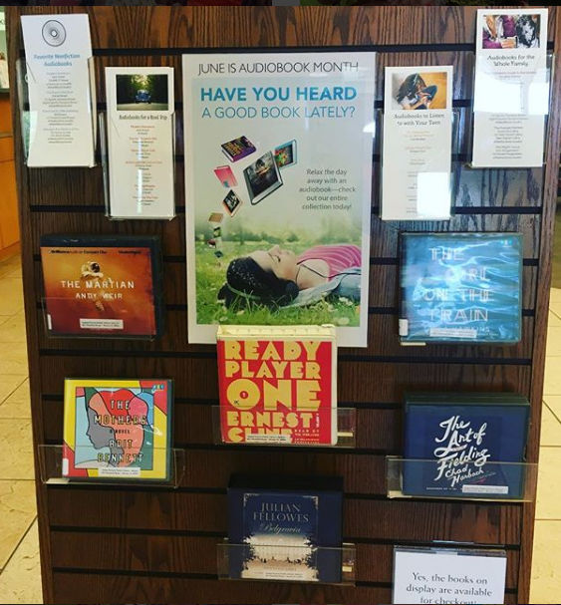
Maximize the reach of your recommendations
Don’t reinvent the wheel. Take advantage of work you’ve already done.
Once you have a bibliography, you can turn it into…displays!

Slide 5
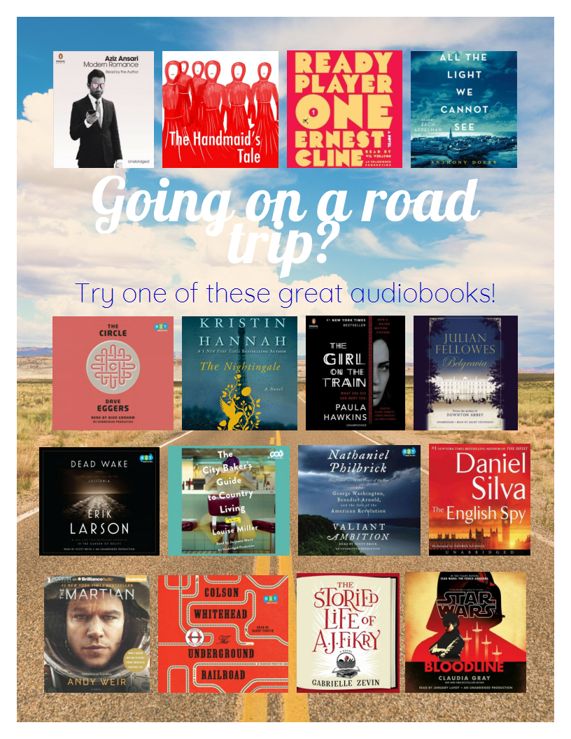
Maximize the reach of your recommendations
Don’t reinvent the wheel. Take advantage of work you’ve already done.
Once you have a bibliography, you can turn it into…posters!

Slide 6
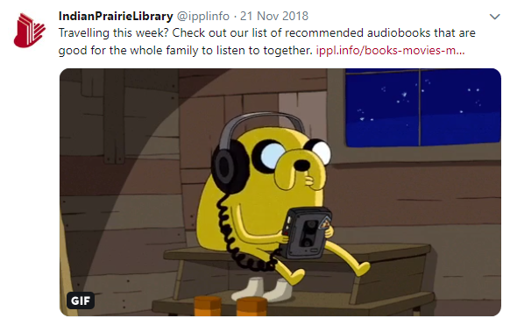
Maximize the reach of your recommendations
Don’t reinvent the wheel. Take advantage of work you’ve already done.
Once you have a bibliography, you can turn it into…social media posts!

Slide 7
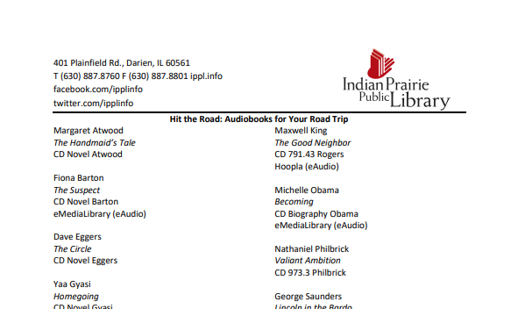
Maximize the reach of your recommendations
Don’t reinvent the wheel. Take advantage of work you’ve already done.
Once you have a bibliography, you can turn it into…printable handouts!

Slide 8
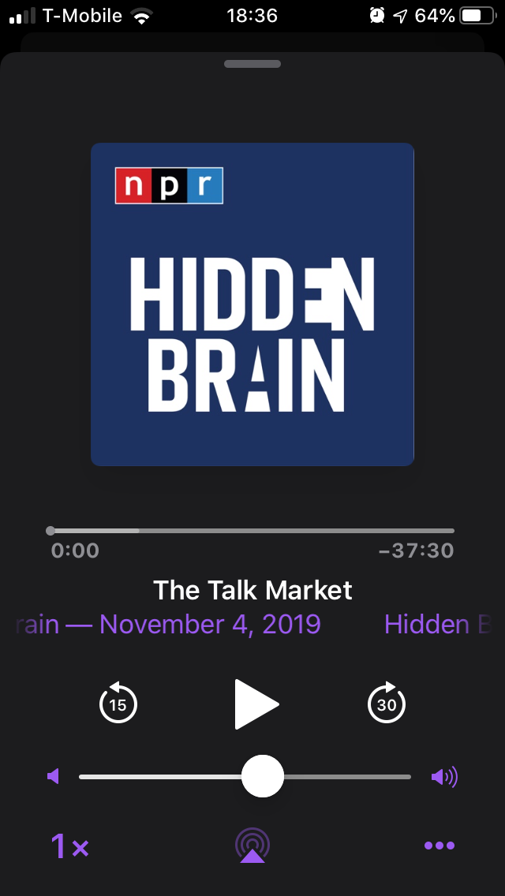
Audiobooks for Podcast Listeners
Consider appeal and topics – what is this podcast about?
Think about the audience – who listens to this?
Do the podcast hosts have books of their own?
What are some of the books mentioned on the podcast?
Check the episode notes or the podcast’s website (if applicable) to find lists of titles, authors, etc.

Slide 9
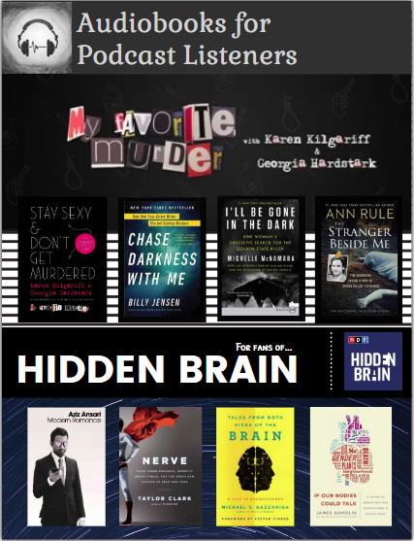
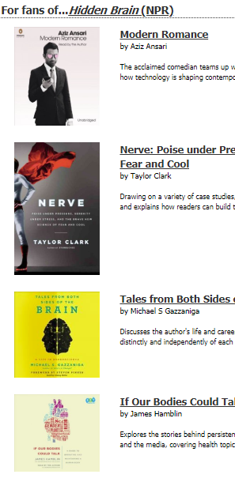
Audiobooks for Podcast Listeners

Slide 10
Book Buzz for Book Clubs
2-3 staff members book talk suggestions for book clubs
Covers, title/author info, synopsis, keywords, why book clubs would like it
Highlights staff expertise
Promote book club resources – staff will pull together author information, reviews, and discussion questions
Invite all book clubs that request books from the library
Attendees share their favorites from the last year, which staff will compile and email to everyone
Group shares how to have a great discussion (wine) and how to handle difficult topics or “problem” members
Notes:
Send out “exclusive” invitations to group leaders

Slide 11
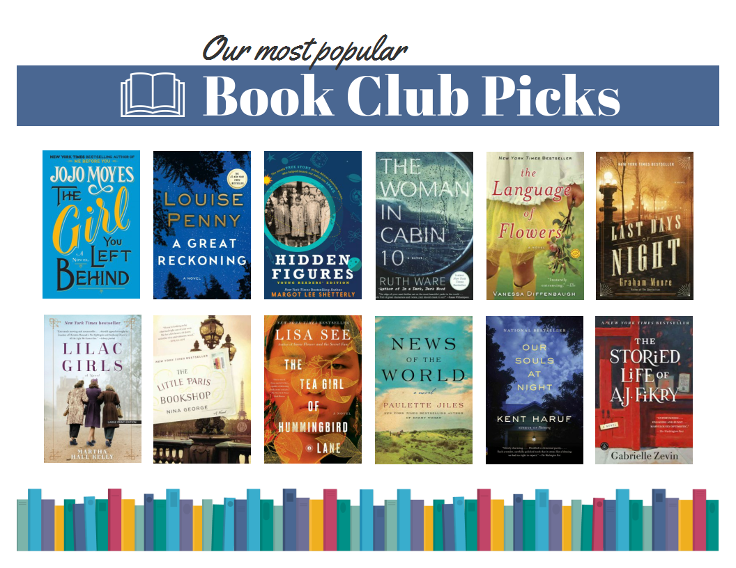
Continue using information after the program!
You can use patron-generated content, too!
Compile a list of the most requested book club titles and the ones patrons said made for great discussions.
Leave off any titles that would be too difficult to obtain enough copies for a book club.
Notes:
Spring 2019

Slide 12
New Way RA
Stacey Peterson, Batavia Public Library
Face Out

Slide 13
“Batavia River Walk 091” by Michael Kappel is licensed by
CC BY-NC 2.0

Slide 14
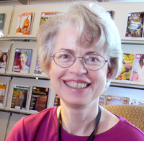
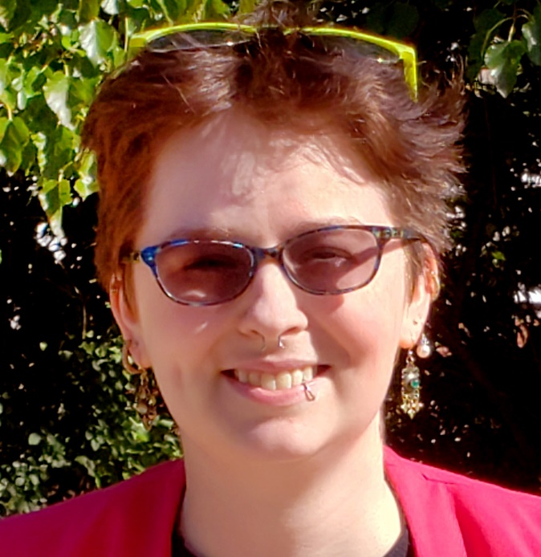
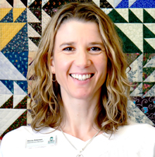
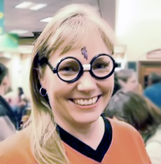
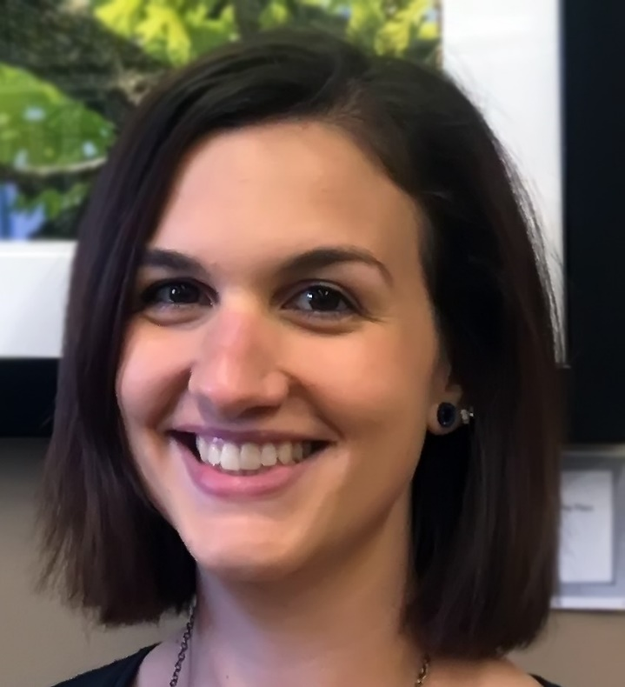
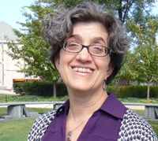
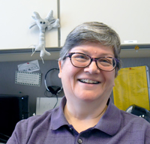
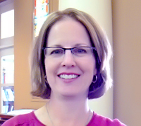

Slide 16
Must haves: + Book cover + Staff photo

Slide 17
Staff-specific book displays Again: staff photo!

Slide 23
Re-use that content!

Slide 24
Subscription Boxes for all ages
Emily Borsa
Adult Services Librarian
Hinsdale Public Library
eborsa@hinsdalelibrary.info
630.986.1976 x4214
Notes:
Now I am going to kick-off the discussion of subscription boxes.

Slide 25
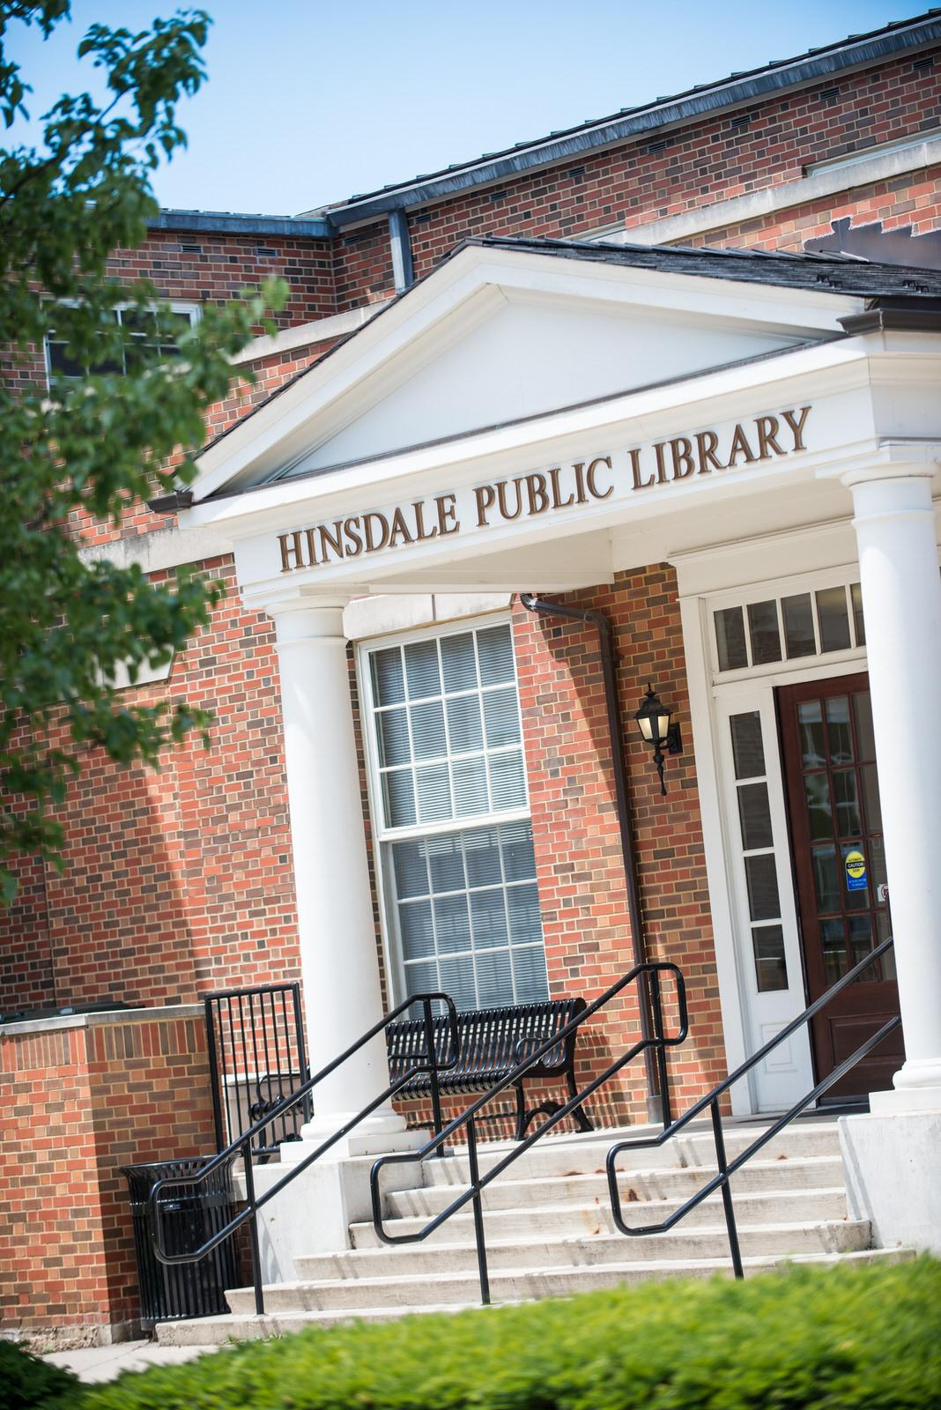
Hinsdale Public Library
Population: 17,700
Median age: 41
Cardholders: 8,330
Adult Staff size: 4 full time, 5 part time
YS/YA Staff size: 3 full time, 5 part time

Slide 26
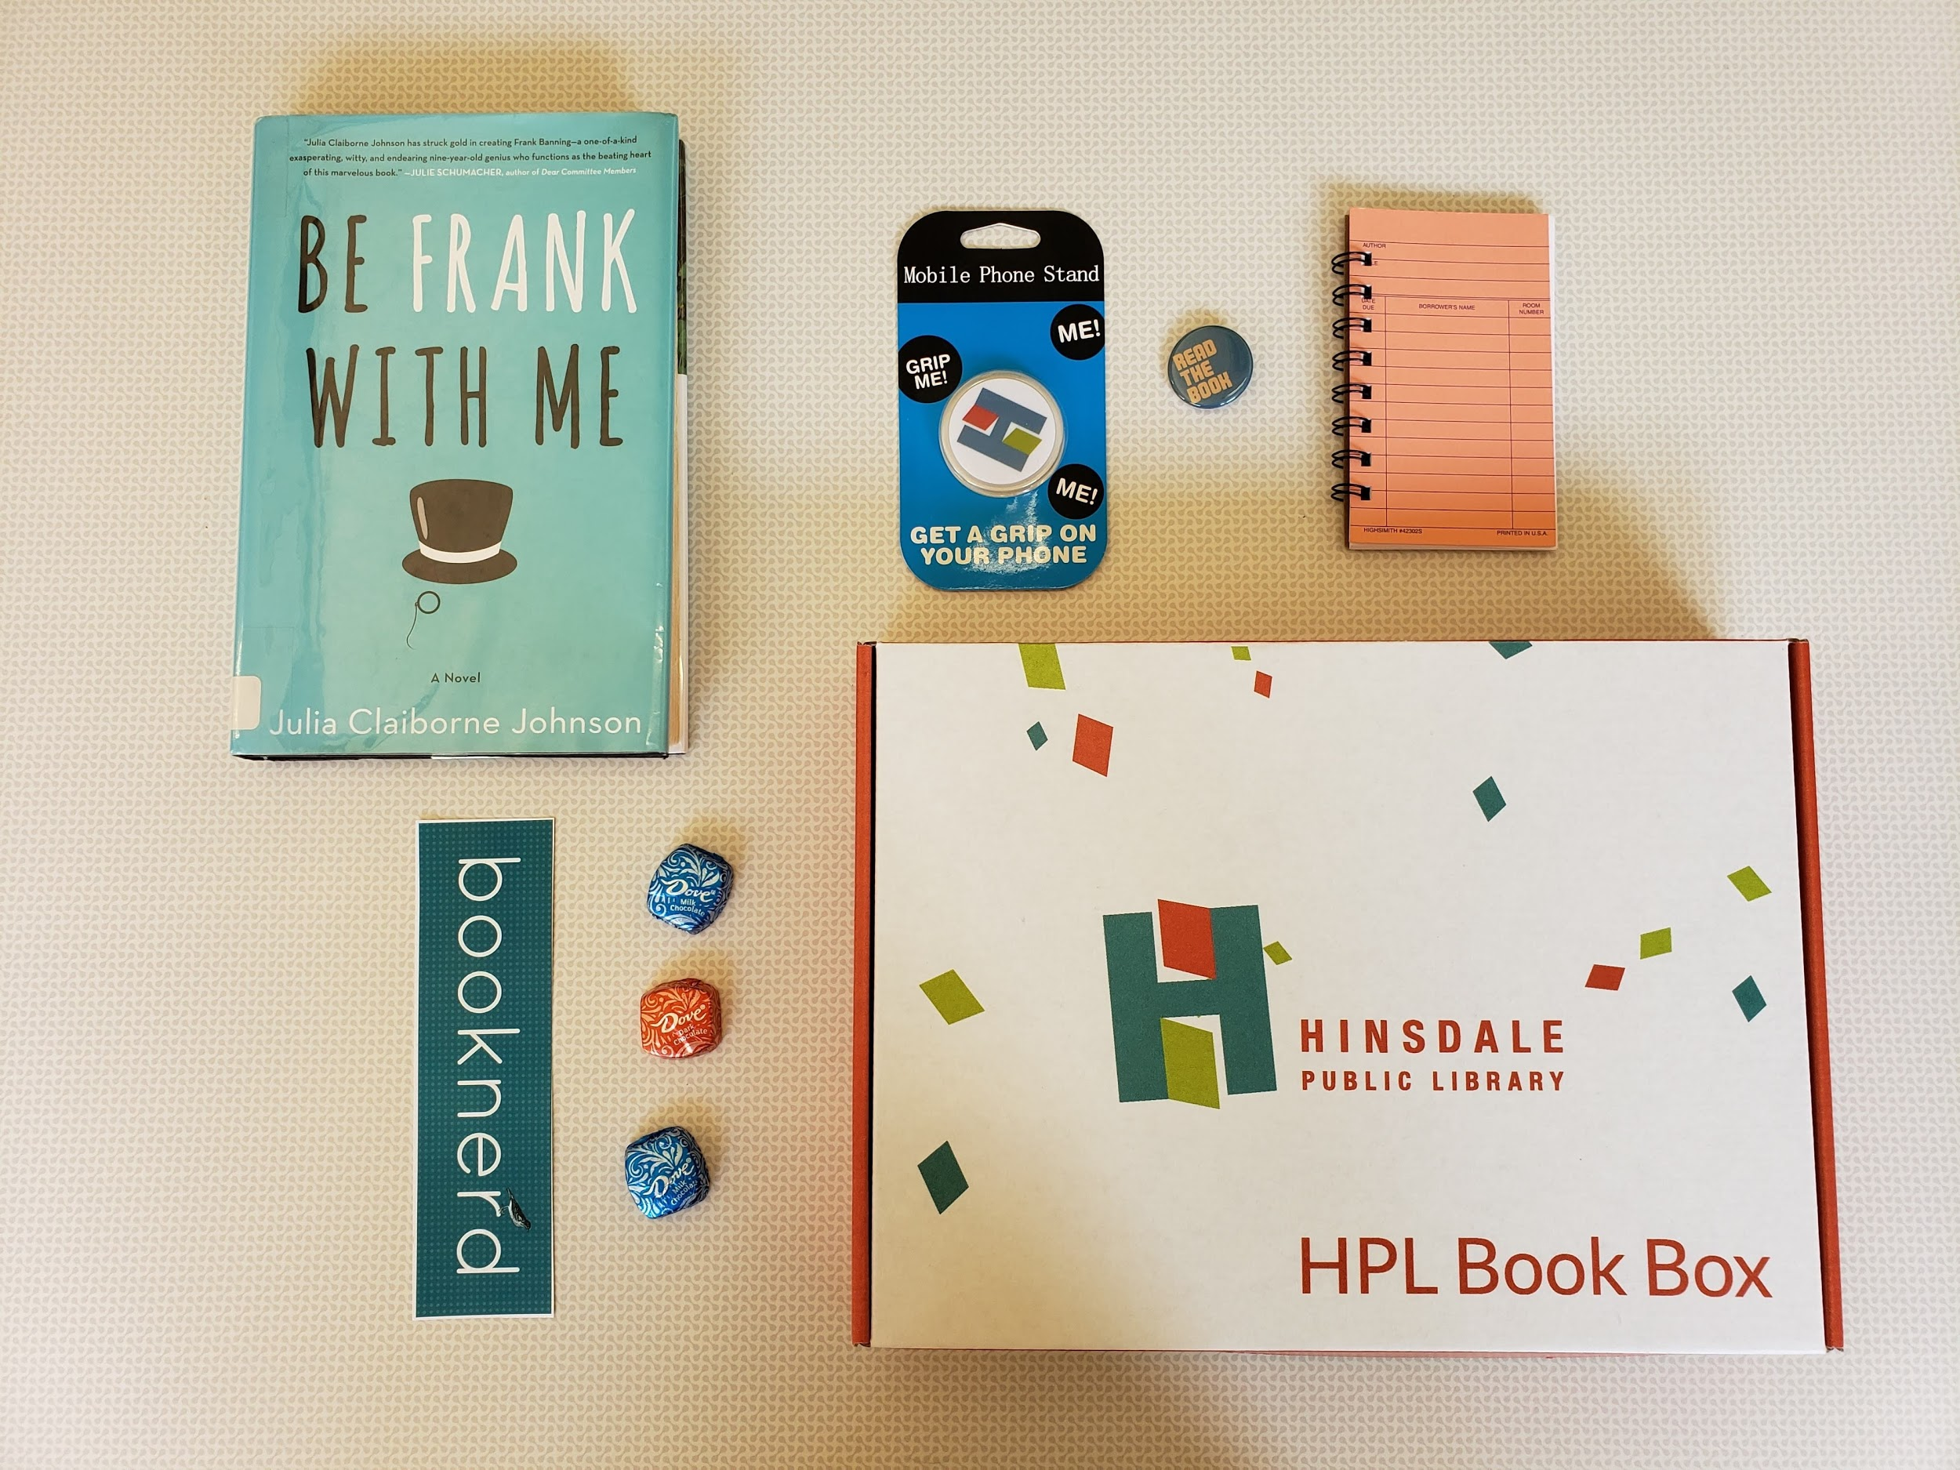
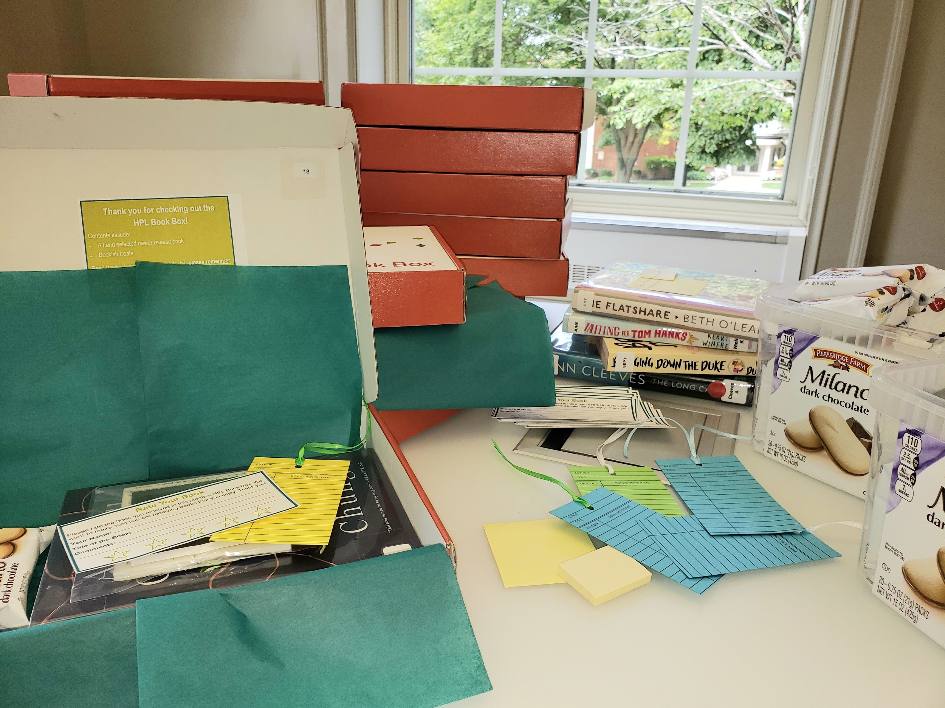
HPL Book Box
Notes:
-The original Teen box was a huge success & I was so impressed by Melisa & Allison’s creativity that I wanted to offer this program for adults too. They generously shared all of their knowledge regarding the box vendor, registration process, record keeping and resources that I was able to hit the ground running and HPL Book Box for adults was rolled out in June 2018 - Teen/Jr/Adult boxes are primarily the same from a logistical standpoint with the boxes we order, review cards used, tracking subscribers & books on spreadsheets, etc. - - - - -Some tweaking was done...such as changing the box size to accommodate bigger books (12x9x2 @ $2.79/box) & a color change to reflect our department. Other differences are in the presentation (tissue paper vs. confetti) and the types of “extras” that are included with the book. I try to put 3 items in the box each month such as tea, individually wrapped chocolate or cookies, a small candle, bookmarks, and the occasional “bookish” sticker or a crafty item that I make myself. - I use Pinterest a lot when looking for ideas for the “extras”. I also look at the websites for the fee based book boxes to see what they add...LitJoy, Once Upon A Book Box, The Bookish Box, etc.

Slide 27
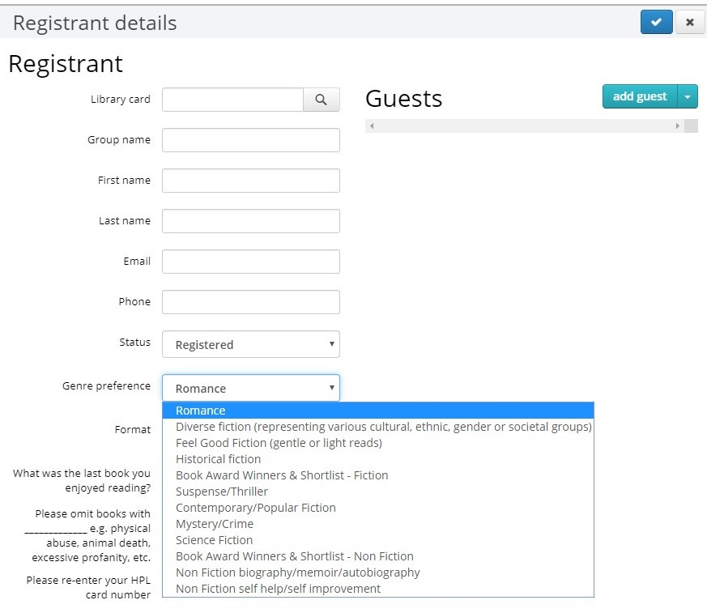
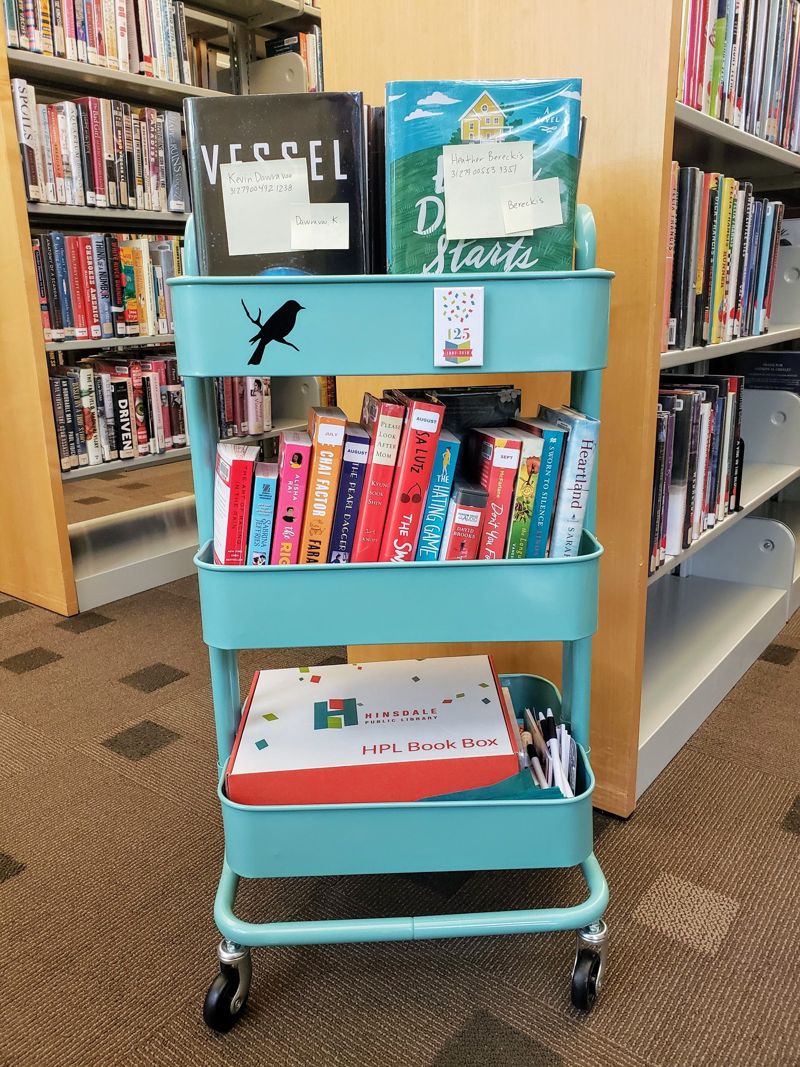

Slide 28
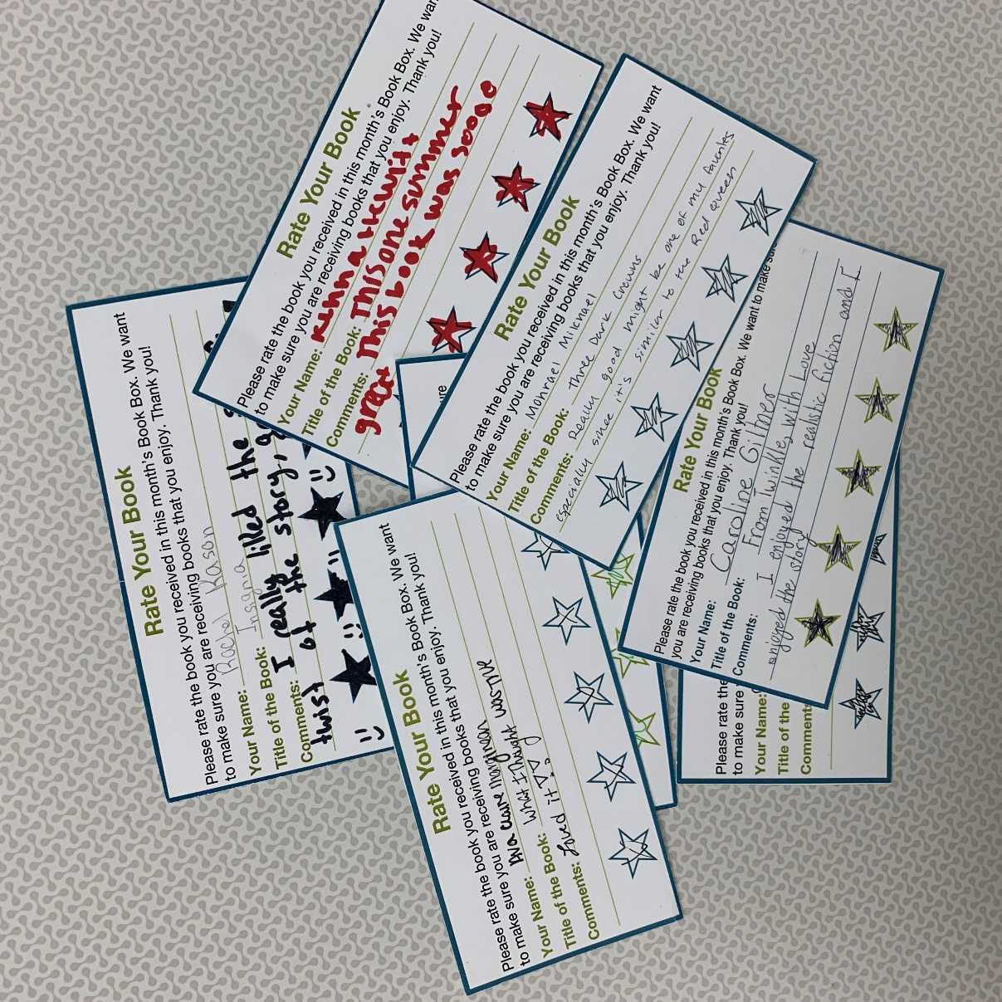
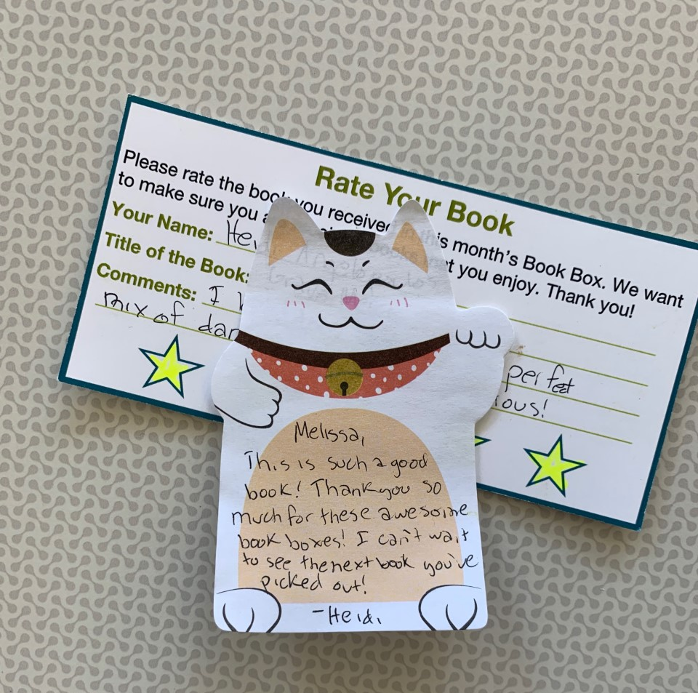
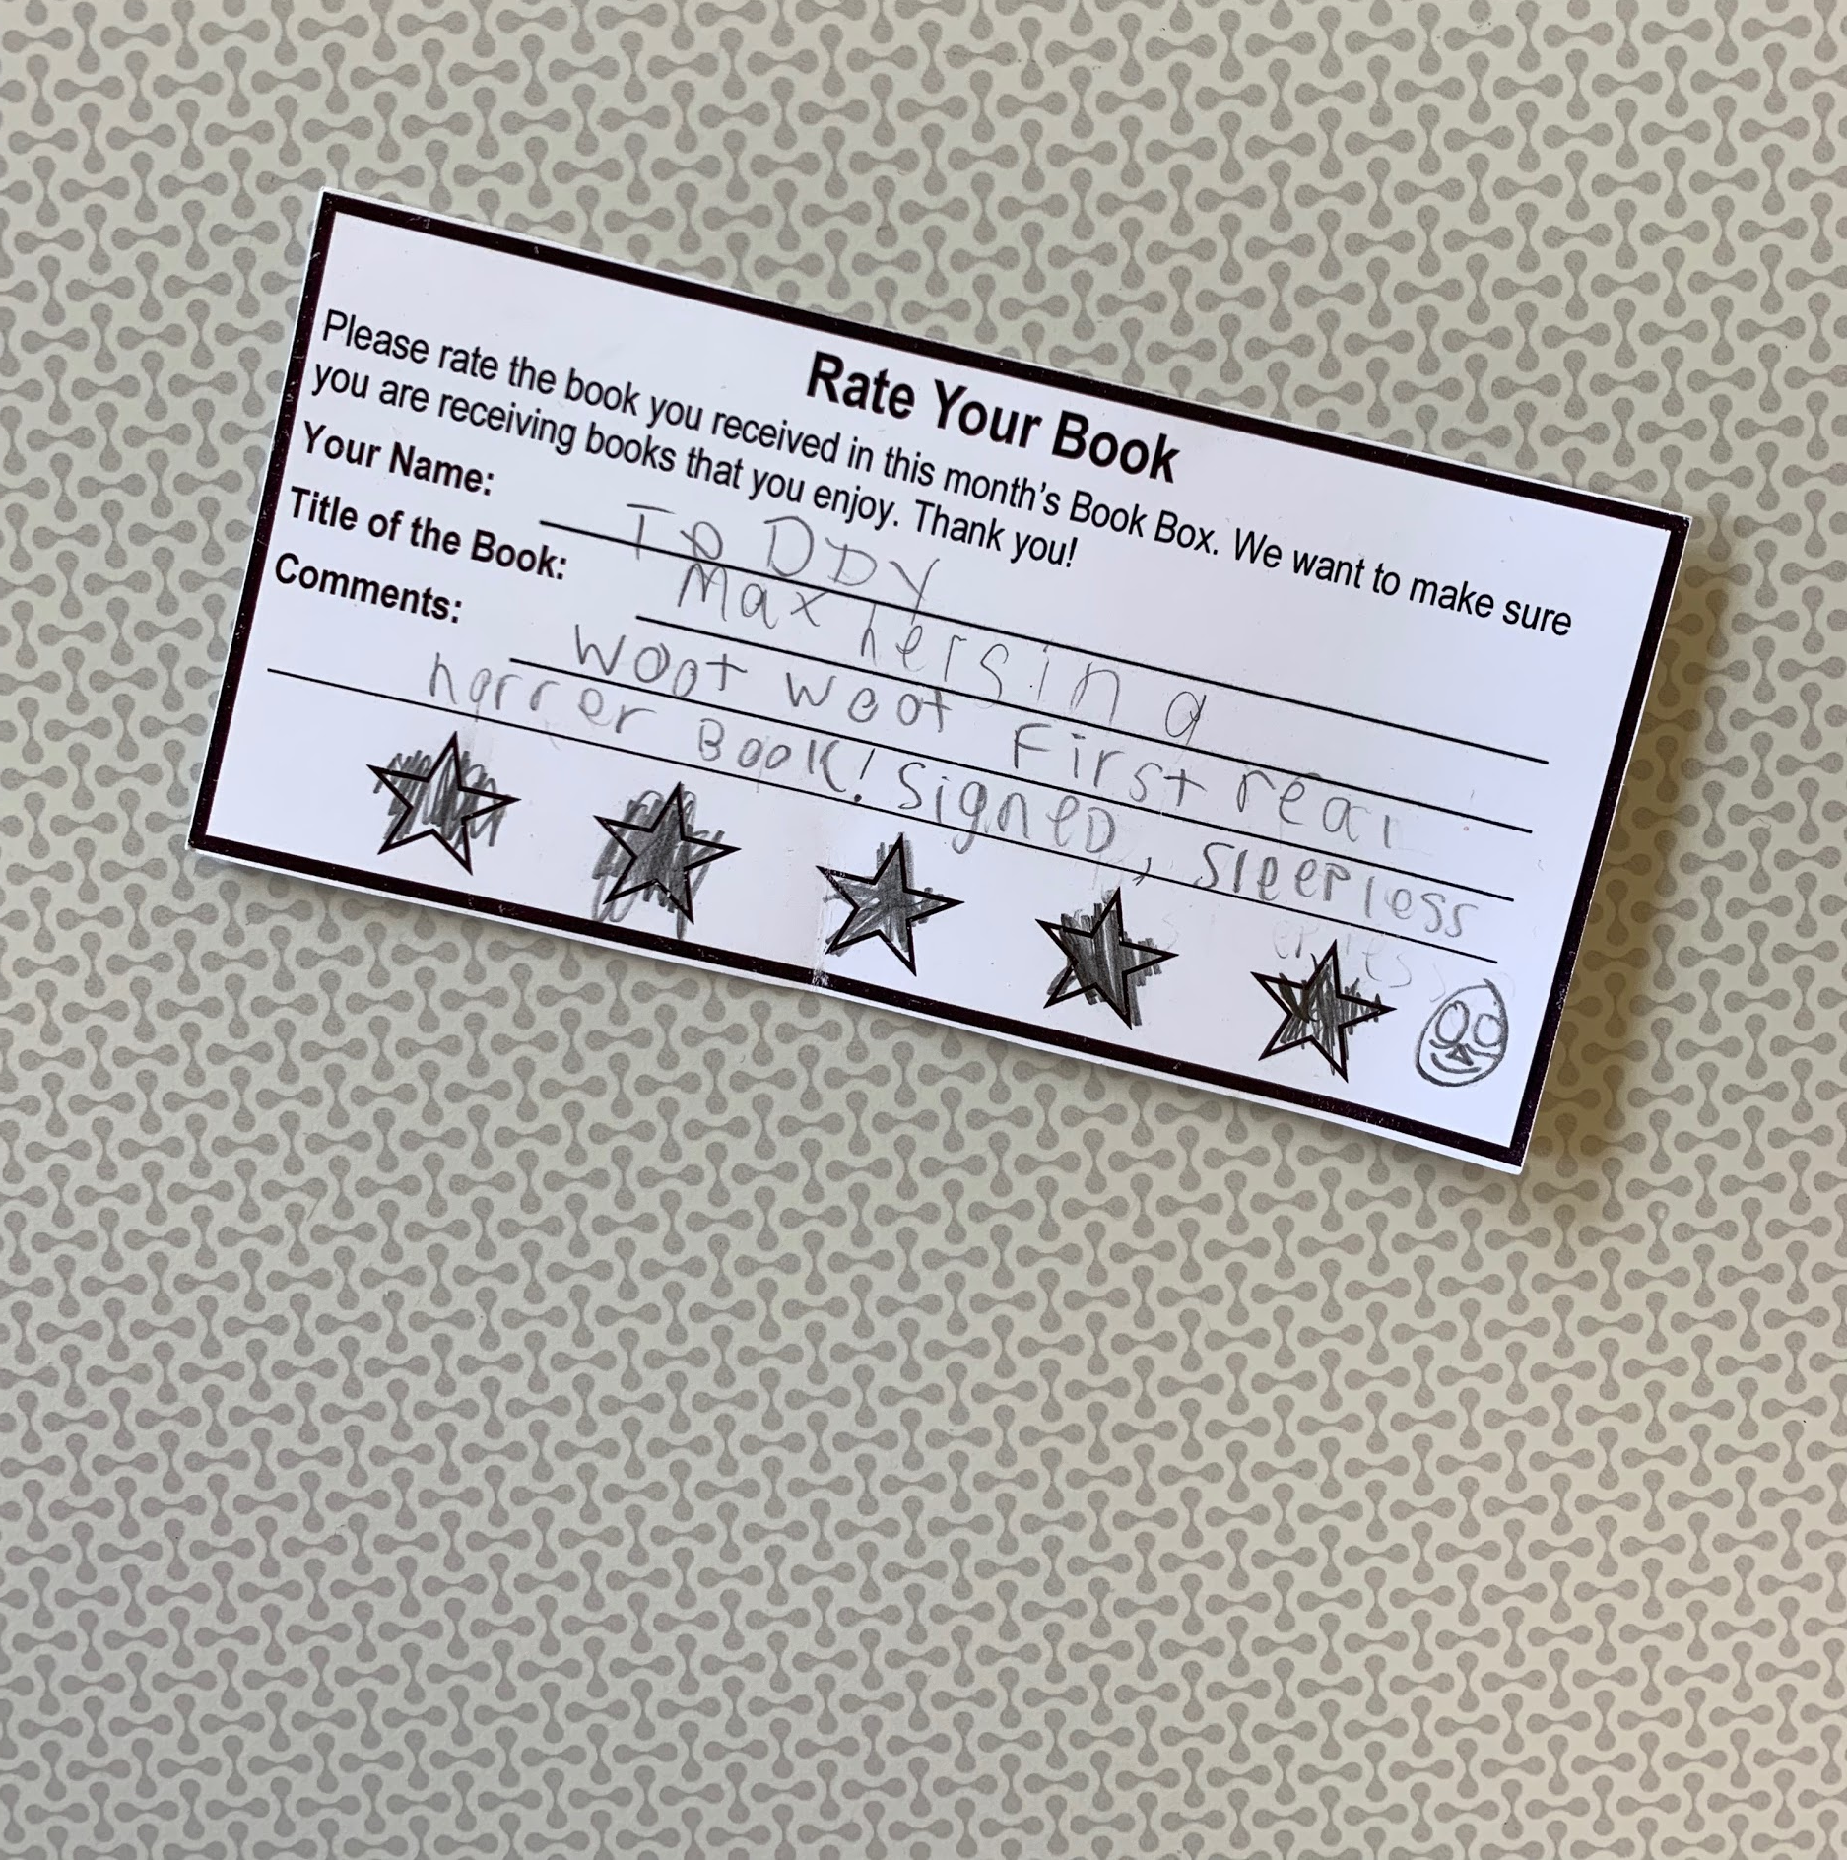
Review Cards
Notes:
When Melisa first came up with the idea to create the book boxes, she was hoping it would help the teen collection get higher circulation numbers and as a way to offer a more passive program since many teen patrons at HPL are too busy to attend regular library programming.
Then I realized it could also be a really amazing RA tool, and that is when I thought of the Rating Card. This is my absolute favorite part of the boxes.
Started with only stars then added comments. Duh moment. Picking out the books and reading the review cards is always a blast.
I pick new and old books that I think the patron will enjoy. I generally stick to the genres they give me, but I do throw in a some surprises if I read a book and love it and think they would like it. Plus, maybe they haven’t tried that genre yet and they will find a new favorite! They will let me know on those review cards if they didn’t like something, which is great!
Most of the cards are positive, but any feedback is much appreciated. Some of my favorites.
“Best one yet! I loved it!”
“I liked the book so much I got my own copy.”
“I stayed up all night reading this book. It captivated me. More books like this one!”

Slide 29
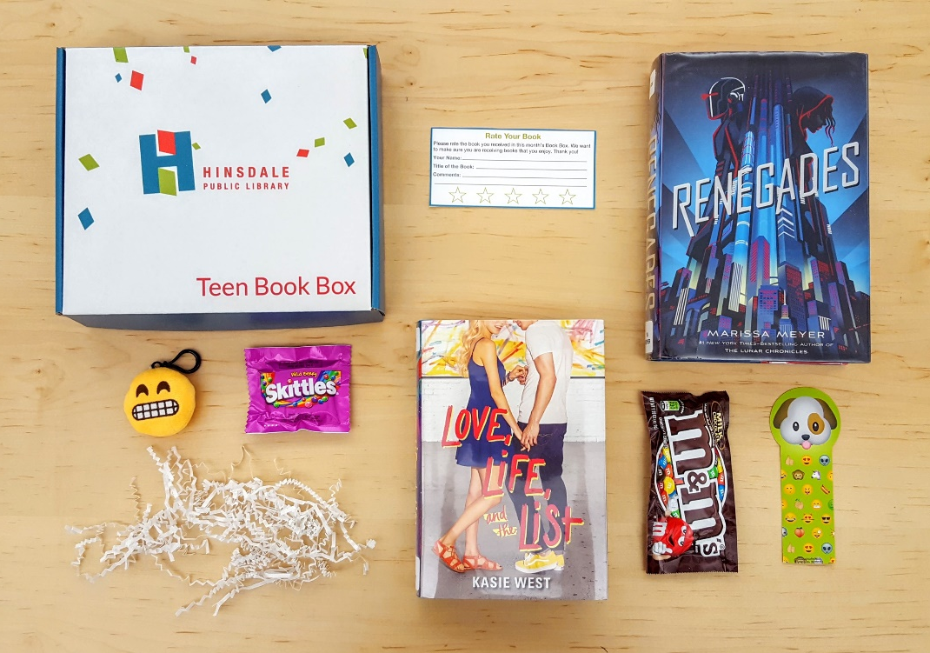
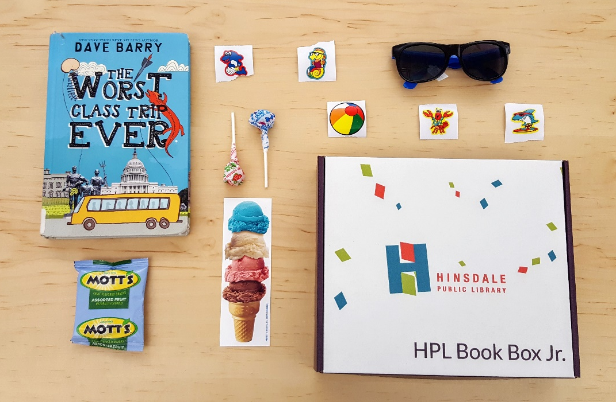
Teen Book Box and Book Box Jr.
Notes:
What are Subscription boxes for all ages?
It’s a three month library version of a subscription box (like Owl Crate), where patrons register once every 3 months for a specially selected book according to the patron’s genre choices and interests/dislikes. They also receive some fun trinkets and candy.
When Melisa first came to me saying she wanted to create a teen book box, my first thought, “this is going to be a lot of work.” and then in the next second I got excited, and together we launched the first round of Teen Book Boxes for 6th -12th grade in December 2016. We started out with only 12 teens registering a month and now have 30+. Since it became so popular, we then we kicked off Book Box Jr. in June 2018 for 4th and 5th graders.
Why book boxes?
The boxes reach a group of patrons that don’t normally attend library programing, such as teen patrons that love to read, but due to sports, school, and other activities don’t have time to come to an organized library program at a set time.
The boxes are a fun and unique way to conduct readers’ advisory.
They can also help increase circulation stats on your collection, especially when you include books you think deserve more attention than they are getting.

Slide 30
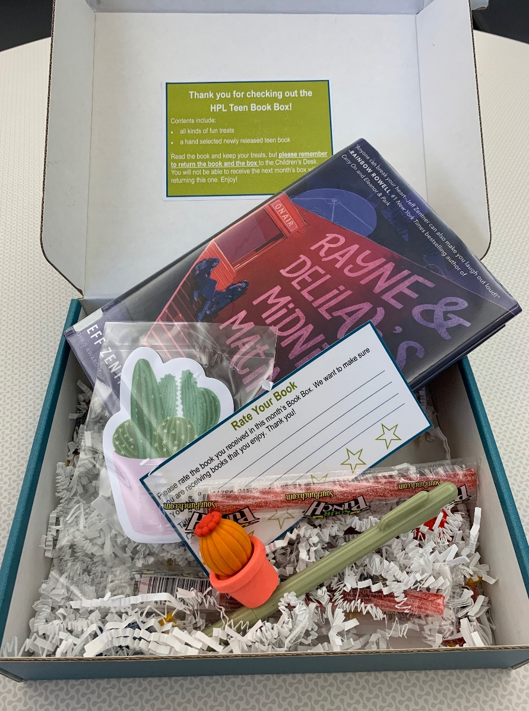
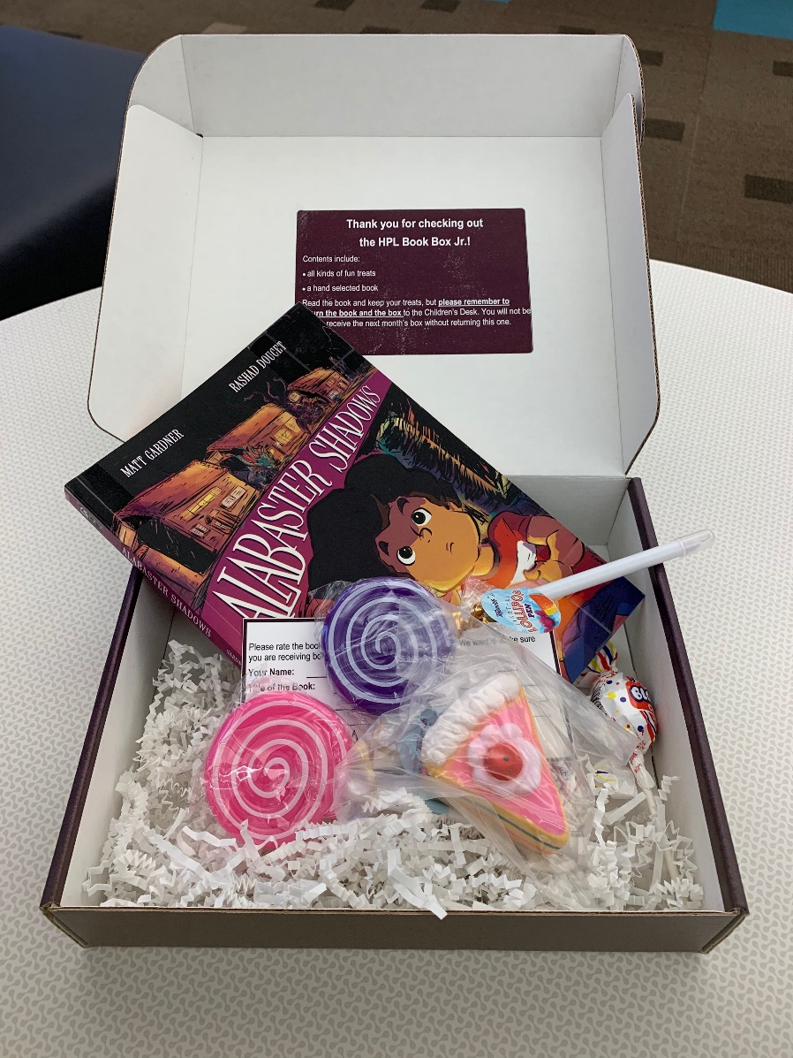
What is inside?
Notes:
Trinkets surrounded around a theme (food, space, Harry Potter, summer, narwhals, ect.)
Bookmarks, pens, sticky notes, keychains, stickers, etc.
Of course, candy!
A review card to rate their book. - I will talk about in a second
Crinkle paper to jazz it up. I use fun tissue paper at Schaumburg.

Slide 31
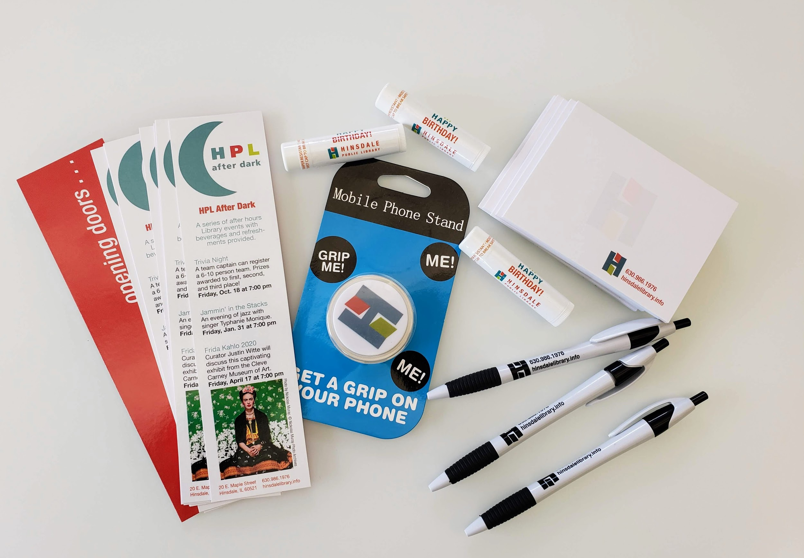
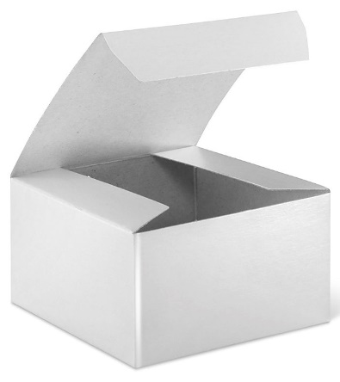
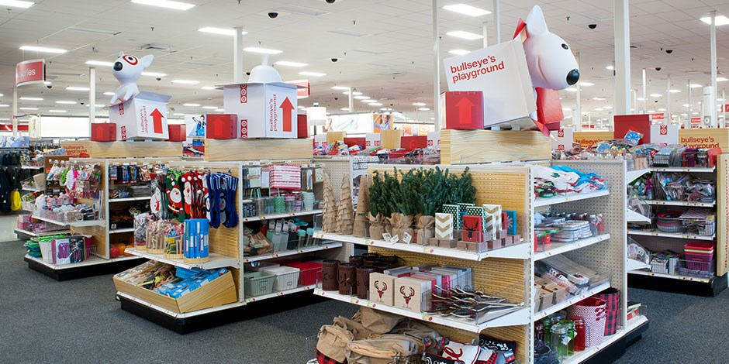
Replicating on a Budget
Notes:
There are a lot of ways to replicate this program on a budget. Patrons love the hand picked library book & little extras each month more than the vehicle used to deliver items to patrons. One regular subscriber commented that opening her monthly box was “like having a birthday every month without getting any older” - Simpler boxes or reusable bags would work just as well as a custom box. - Free printable bookmarks are abundant on Pinterest, Amazon sells bulk candy, tea and other treats at an affordable “per item” cost. - Oriental Trading and the Dollar Spot at Target are always a good option and many Etsy vendors are willing to work within a budget for bulk sales. - Library swag is a great way to round out a box without tapping into your program budget...pens, post it notes, etc. Book club brochures from publishers are popular too. I also utilize library tools such as the Ellison machine and vinyl cutter to make cute items for the boxes. - And the real star, the library book, is always free!

Slide 32
Questions?
Jez Layman Stacey Peterson Emily Borsa
Indian Prairie Public Library
Batavia Public Library
Hinsdale Public Library
jezl@ippl.info
speterson@bataviapubliclibrary.org
eborsa@hinsdalelibrary.info

